Slide 1
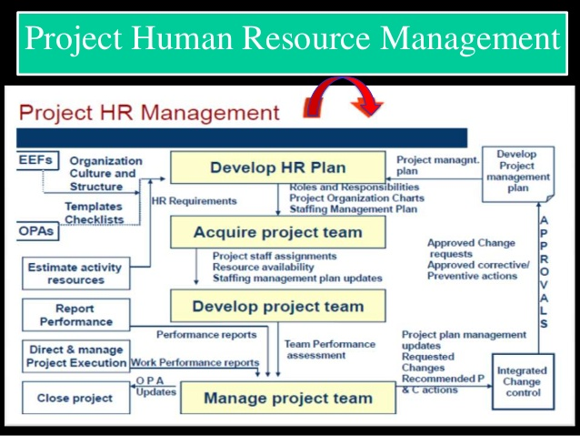

Slide 2
Project HRM Overview
The process of identifying and documenting project roles, responsibilities, required skills, reporting relationships, and creating a staffing management plan.
Plan HRM
The process of confirming human resource availability and obtaining the team necessary to complete project activities.
Acquire Project Team
Develop Project Team
The process of improving competencies, team member interaction and overall team environment to enhance project performance.
Manage Project Team
The process of tracking team member performance , providing feedback, resolving issues, and managing changes to optimize project performance.

Slide 3
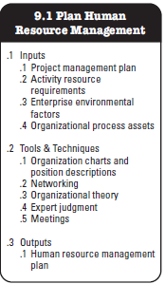
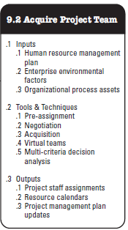
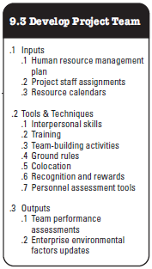
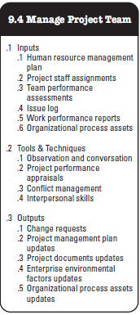
Project Human Resource Management Overview

Slide 4
Organisation Types
Functional
Organization
Project
Organization
Matrix
Organization

Slide 5
Types of Matrix Org
Strong Matrix Structure
Balanced Matrix Structure
Weak Matrix Structure

Slide 6
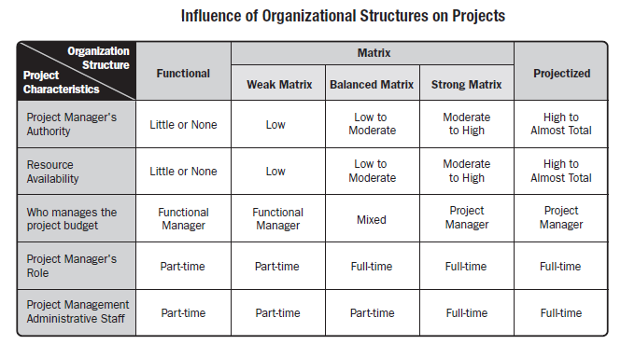
Organizational Structures

Slide 7
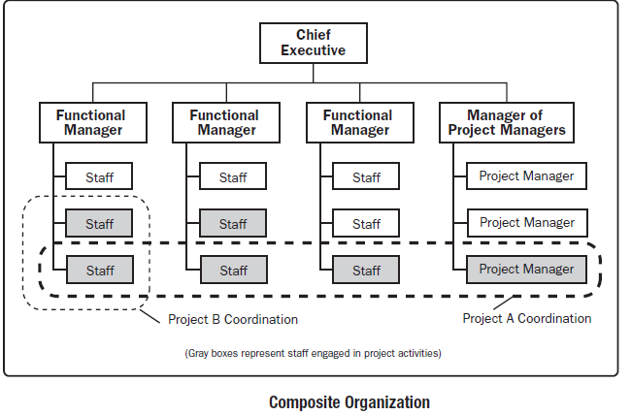
Organizational Structures
Some Organizations use a hybrid (mix) of these structures to meet their varied needs. For example, a functional organization may run a specific project just like it would be run in a projectized organization. Such organizations are called composite organizations

Slide 8
Project Stakeholders
It includes all members of the project team as well as all interested entities that are internal or external to the organization.
The project team identifies external and internal, positive & negative and performing and advising stakeholders in order to determine the project requirements and the expectations of all parties involved.
The project manager should manage the influence of these various stakeholders in relation to project requirements to ensure a successful outcome.

Slide 9
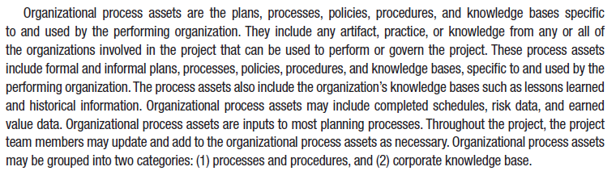
Organizational Process Assets

Slide 10
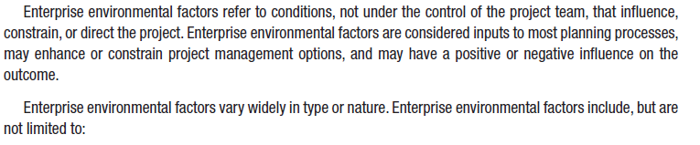
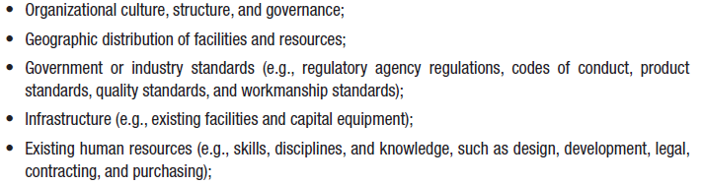
Enterprise Environmental Factors

Slide 11
Stakeholders?
“Stake holders are the persons and Organisation, Sponsors, performing Organisations and Public actively involved in the Project or whose interests will be positively or negatively impact by the execution of the project or who may impacted the project”

Slide 12
Project Stakeholder Management Processes
Identifying stakeholders: Identifying everyone involved in the project or affected by it, and determining the best ways to manage relationships with them.
Planning stakeholder management: Determining strategies to effectively engage stakeholders
Managing stakeholder engagement: Communicating and working with project stakeholders to satisfy their needs and expectations, resolving issues, and fostering engagement in project decisions and activities
Controlling stakeholder engagement: Monitoring stakeholder relationships and adjusting plans and strategies for engaging stakeholders as needed

Slide 13
Identifying Stakeholders
Internal project stakeholders generally include the project sponsor, project team, support staff, and internal customers for the project. Other internal stakeholders include top management, other functional managers, and other project managers
External project stakeholders include the project’s customers (if they are external to the organization), competitors, suppliers, and other external groups that are potentially involved in the project or affected by it, such as government officials and concerned citizens

Slide 14
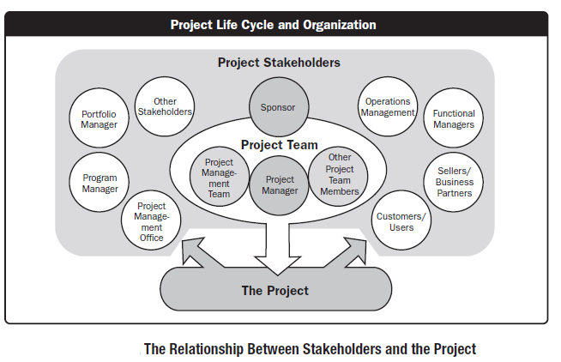
Project Stakeholders

Slide 15
Roles & Responsibilities
Sponsor
PM
Costumer
Project team
SMEs

Slide 16
PM’s Skill
Leadership
Communications
Organizing
Negotiating
Managing conflict
Motivating
Controlling
Team building
Planning
Directing
Problem solving
Coaching
Delegating
Supporting

Slide 17
Additional Stakeholders
  Program director
  Project manager’s family
  Labor unions
  Potential customers
It is also necessary to focus on stakeholders with the most direct ties to a project, for example only key suppliers

Slide 18
Stakeholder Register
A stakeholder register includes basic information on stakeholders:
  Identification information: The stakeholders’ names, positions, locations, roles in the project, and contact information
  Assessment information: The stakeholders’ major requirements and expectations, potential influences, and phases of the project in which stakeholders have the most interest
  Stakeholder classification: Is the stakeholder internal or external to the organization? Is the stakeholder a supporter of the project or resistant to it?

Slide 19
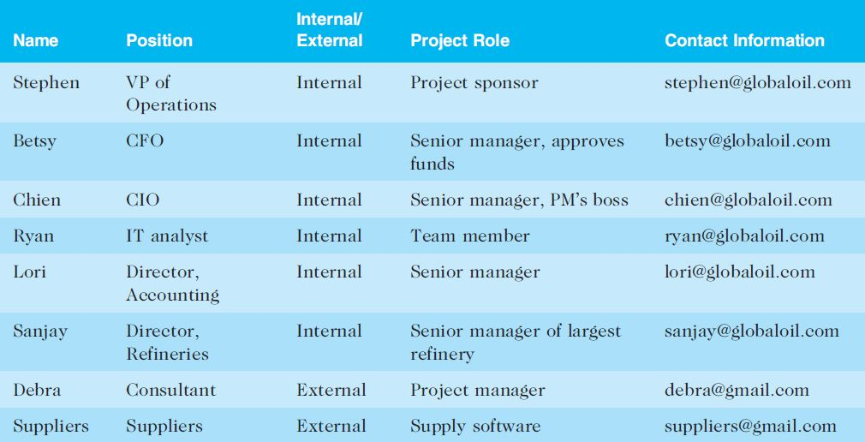
Sample Stakeholder Register

Slide 20
Classifying Stakeholders
After identifying key project stakeholders, you can use different classification models to determine an approach for managing stakeholder relationships
A power/interest grid can be used to group stakeholders based on their level of authority (power) and their level of concern (interest) for project outcomes

Slide 21
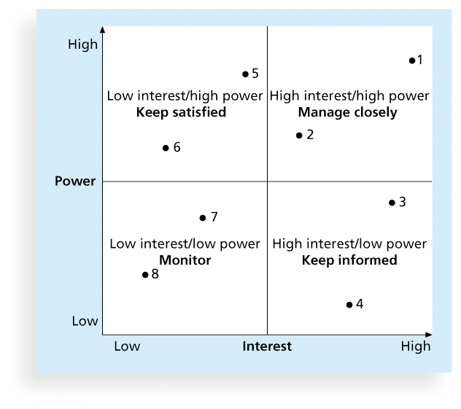
Power/Interest Grid

Slide 22
Stakeholder Engagement Levels
Unaware: Unaware of the project and its potential impacts on them
Resistant: Aware of the project yet resistant to change
Neutral: Aware of the project yet neither supportive nor resistant
Supportive: Aware of the project and supportive of change
Leading: Aware of the project

Slide 23
Issue Logs
Understanding the stakeholders’ expectations can help in managing issues
Issues should be documented in an issue log, a tool used to document, monitor, and track issues that need resolution
Unresolved issues can be a major source of conflict and result in stakeholder expectations not being met
Issue logs can address other knowledge areas as well

Slide 24
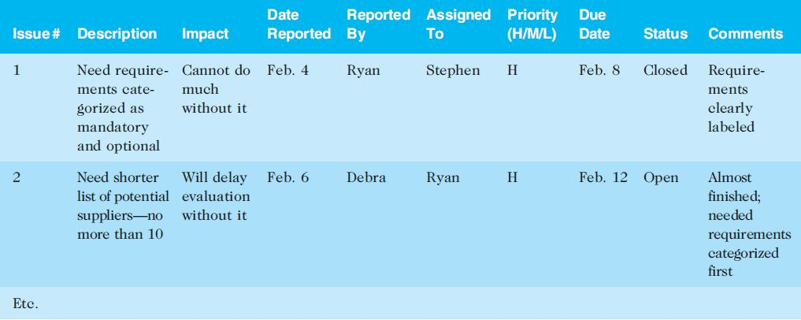
Sample Issue Log

Slide 25
5 Stages of Group Development (Tuckman)
Forming
Storming
Norming
Performing
Adjourning

Slide 26
5 Stages of Group Development
Stage | Theme | Issue
Forming | Awareness | Inclusion
Storming | Conflict | Control
Norming | Cooperation | Cohesion
Performing | Productivity | Team Identity
Adjourning | Separation | Completion

Slide 27
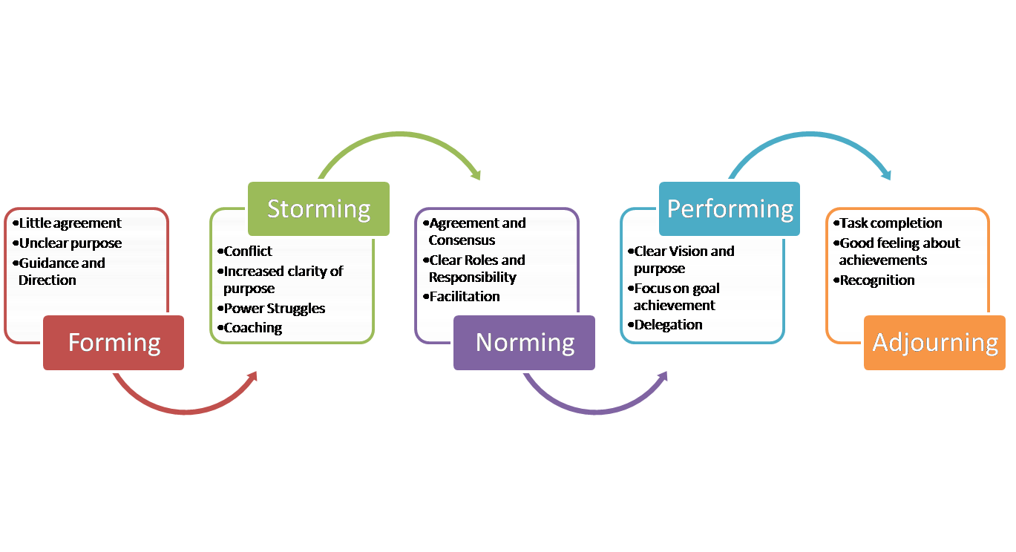

Slide 28
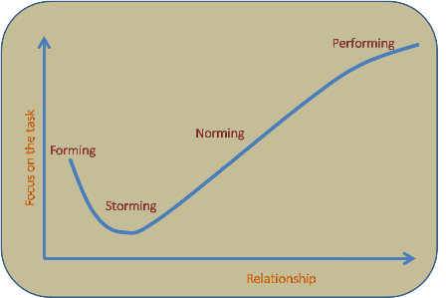

Slide 29
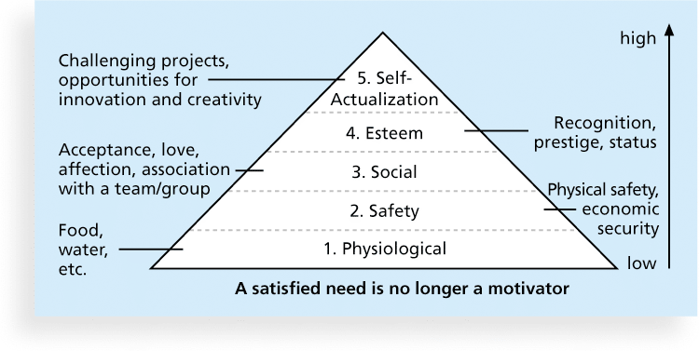
Figure 9-2. Maslow’s Hierarchy of Needs

Slide 30
Herzberg’s Motivational and Hygiene Factors
Frederick Herzberg wrote several famous books and articles about worker motivation. He distinguished between:
  Motivational factors: Achievement, recognition, the work itself, responsibility, advancement, and growth. These factors produce job satisfaction.
  Hygiene factors: Larger salaries, more supervision, and a more attractive work environment. These factors cause dissatisfaction if not present, but do not motivate workers to do more
  Poor hygiene factors may destroy motivation, under most circumstances, will not improve motivation. (you can include more examples in hygiene factor personal life, relationship at work, security and status

Slide 31
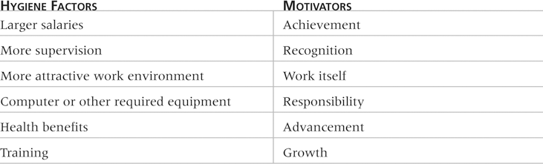
Table 9-1: Examples of Herzberg’s Hygiene Factors and Motivators

Slide 32
McClelland’s Acquired-Needs Theory
Specific needs are acquired or learned over time and are shaped by life experiences. The following are the main categories of acquired needs:
  Achievement (nAch): People with a high need for achievement like challenging projects with attainable goals and lots of feedback.
  Affiliation (nAff): People with high need for affiliation desire harmonious relationships and need to feel accepted by others, so managers should try to create a cooperative work environment for them.
  Power (nPow): People with a need for power desire either personal power or institutional power). Provide institutional power seekers with management opportunities.

Slide 33
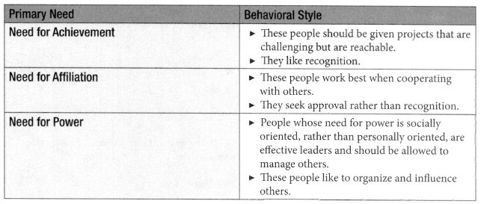
Motivation Theory
David McClelland's Theory of Need
  People are motivated by fulfilling one of the following needs

Slide 34
McGregor’s Theory X and Y
Douglas McGregor popularized the human relations approach to management in the 1960s.
Theory X: Assumes workers dislike and avoid work, so managers must use coercion, threats, and various control schemes to get workers to meet objectives.
Theory Y: Assumes individuals consider work as natural as play or rest and enjoy the satisfaction of esteem and self-actualization needs.

Slide 35


Motivation Theory
McGregor’s Theory of X & Y
Theory X people are incapable. Avoid responsibility & avoid work whenever possible
Theory Y people are willing to work without supervision and want to achieve

Slide 36
Powers of Project Manager
Formal (legitimate)
  Based on position
Reward
  Stems from giving rewards
Penalty (coercive)
  Comes from ability to penalize team members
Expert
  Comes from being the technical or project management expert
Referent
  Comes from another person liking you

Slide 37
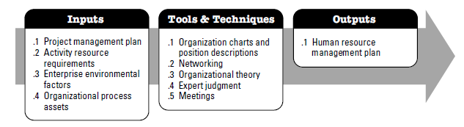
Project Human Resource Management Overview
Plan Human Resource Management
The process of identifying and documenting project roles, responsibilities, required skills, reporting relationships, and creating a staffing management plan. The key benefit of this process is that it establishes project roles and responsibilities, project organization charts, and the staffing management plan including the time table of staff acquisition and release.

Slide 38
Project Human Resource Management Overview
Plan Human Resource Management
Contains following aspects;
Identification of training needs
Team building strategies
Plans for recognition and rewards programs
Compliance considerations
Safety issues
Impact of staffing management plan on the organization

Slide 39
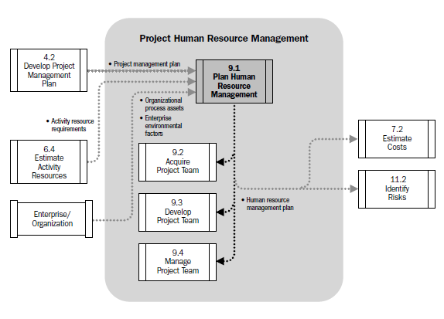
Human Resource Management Data Flow Diagram

Slide 40
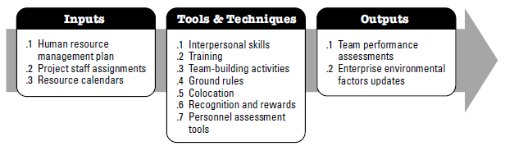
Develop Project Team
Develop Project Team is a process of improving competencies. Team member interaction and overall team environment to enhance project performance.

Slide 41
Work Breakdown Structure (WBS)
Breakdown of project deliverables. How project deliverables are broken down into work packages provide a way of showing high-level areas of responsibility
Organizational Breakdown Structure (OBS)
OBS is arranged according to an organization's existing departments, units or teams with the project activities or work packages listed under each department.
Hierarchical list of resources related by category and resource type that is used to facilitate planning and controlling of project work. Each descending level represents an increasingly detailed description of the resource until small enough to be used in conjunction with WBS to allow the work to be planned, monitored and controlled.
Resource Breakdown Structure (RBS)
It may contain resource categories other than human resources

Slide 42
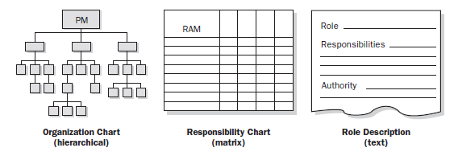
Organization Chart & Position Descriptions
The objective is to ensure that each work package has an unambiguous owner and that all team members have a clear understanding of their roles & responsibilities

Slide 43
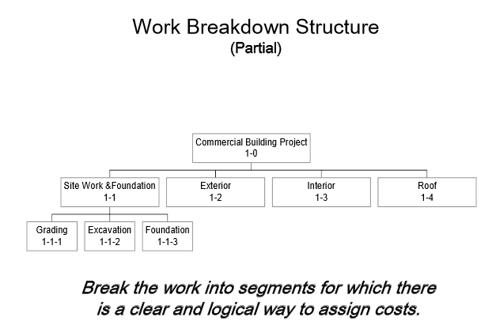
Organization Chart & Position Descriptions

Slide 44
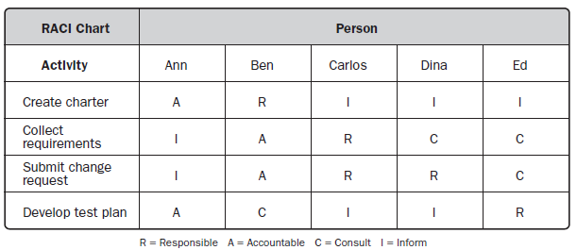
Organization Chart & Position Descriptions
Responsibility Assignment Matrix (RAM)
RAM is a grid that shows the project resources assigned to each work package. It links activities to resources in order to ensure that all work components are assigned to an individual or team

Slide 45
Organization Chart & Position Descriptions
Another variant can be LRC (Linear Responsibility Chart)
It focuses more on naming who is responsible for specified work units at the lower levels of all levels in WBS. As compare to RACI, it shows more of a degree of involvement.

Slide 46
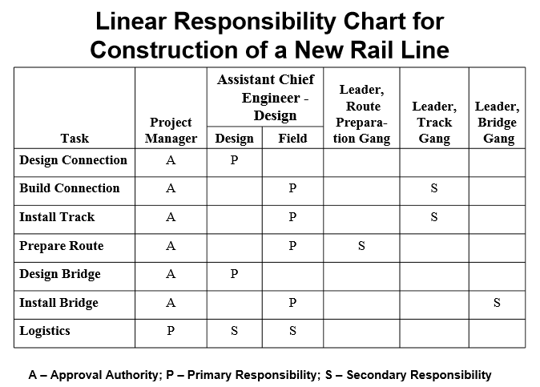
Organization Chart & Position Descriptions

Slide 47
Organization Chart & Position Descriptions
Resource Histogram is a tool that shows number of resources required or assigned over time to a project .
The vertical bars represent the number of people needed in each skill category and by stacking the columns , the total number of resources required for each period can be represented.
This is a handy format to show various stakeholder groups resource views for the project
It can be used to compute the capacity shortages from planned versus available resources.

Slide 48
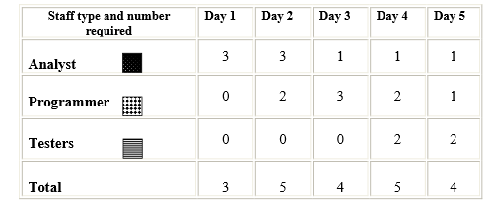
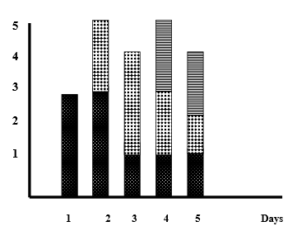
Organization Chart & Position Descriptions

Slide 49
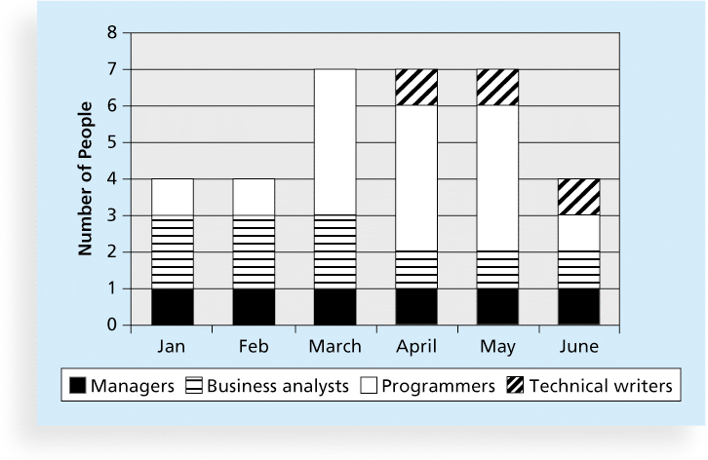
Sample Resource Histogram

Slide 50
A Simple Gantt Chart
Time
J F M A M J J A S
Design
Prototype
Test
Revise
Production

Slide 51
Acquire Project Team – Overview (Cont’d…)
Types of Teams
  Dedicated, Most of team members work full time, easiest team to work, member can dedicate of the energy to work, most common in projectized org, found in matrix, least likely in functional org
  Part-time, spend part of time, also working on other projects or non project work, most often seen in functional and matrix org
  Partnership, where several org undertake project, saving of cost but difficult to manage
  Virtual, multiple organization or offices involved, geographical distance necessitate v teams
Avoiding Pitfalls
  Halo Effect, Halo effect is a concept of unconscious judgment, it is a biased Approach in which an observer's overall impression of some thing. Its works in both positive and negative directions
  Acquire Project Team = Acquire Final Project Team
  Involving people in the work regardless of when they join the project team

Slide 52
Acquire Project Team – Overview (Cont’d…)
Types of Teams
  Dedicated, Most of team members work full time, easiest team to work, member can dedicate of the energy to work, most common in projectized org, found in matrix, least likely in functional org
  Part-time, spend part of time, also working on other projects or non project work, most often seen in functional and matrix org
  Partnership, where several org undertake project, saving of cost but difficult to manage
  Virtual, multiple organization or offices involved, geographical distance necessitate v teams
Avoiding Pitfalls
  Halo Effect, Halo effect is a concept of unconscious judgment, it is a biased Approach in which an observer's overall impression of some thing. Its works in both positive and negative directions
  Acquire Project Team = Acquire Final Project Team
  Involving people in the work regardless of when they join the project team

Slide 53
Acquire Project Team
Acquiring qualified/Talented people for teams is crucial.
Staffing plans and good hiring procedures are important, as are incentives for recruiting and retention.
  Some companies give their employees cash rewards for every hour that a new person who they helped hire works.
  Some organizations allow people to work from home as an incentive.

Slide 54
Acquire HR as People Leave Jobs!
Acquire Project Team
They feel they do not make a difference.
They do not get proper recognition.
They are not learning anything new or growing as a person.
They do not like their coworkers.
They want to earn more money.

Slide 55
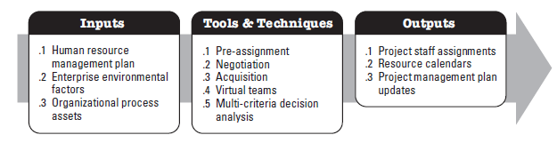
Acquire Project Team

Slide 56
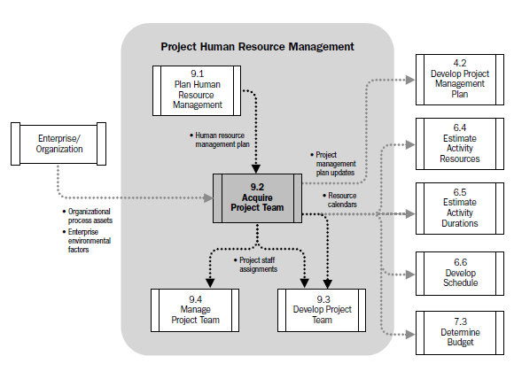
Acquire Project Team

Slide 57
Acquire Project Team – Overview (Cont’d…)
Types of Teams
  Dedicated, Most of team members work full time, easiest team to work, member can dedicate of the energy to work, most common in projectized org, found in matrix, least likely in functional org
  Part-time, spend part of time, also working on other projects or non project work, most often seen in functional and matrix org
  Partnership, where several org undertake project, saving of cost but difficult to manage
  Virtual, multiple organization or offices involved, geographical distance necessitate v teams
Avoiding Pitfalls
  Halo Effect, Halo effect is a concept of unconscious judgment, it is a biased Approach in which an observer's overall impression of some thing. Its works in both positive and negative directions
  Acquire Project Team = Acquire Final Project Team
  Involving people in the work regardless of when they join the project team

Slide 58
Acquire Project Team
Acquiring qualified/Talented people for teams is crucial.
Staffing plans and good hiring procedures are important, as are incentives for recruiting and retention.
  Some companies give their employees cash rewards for every hour that a new person who they helped hire works.
  Some organizations allow people to work from home as an incentive.

Slide 59
Acquire HR as People Leave Jobs!
Acquire Project Team
They feel they do not make a difference.
They do not get proper recognition.
They are not learning anything new or growing as a person.
They do not like their coworkers.
They want to earn more money.

Slide 60
Acquire Project Team - ITTOs
Inputs
  Human Resource Management Plan
  Enterprise Environmental Factors
  Organizational Process Assets
Tools & Techniques
  Pre-Assignment
  Negotiation
  Acquisition
  Virtual Teams
  Multi-criteria Decision Analysis
Outputs
  Project Staff Assignments
  Resource Calendars
  Project Management Plan Updates

Slide 61
Important Factors
Project Management Team may or may not have direct control over team member selection
Affect of the Non- availability of necessary human resource on;
  Project Schedule
  Project Budget
  Project Risks
  Project Quality
  Training Plans
  Project Management Plans as a whole

Slide 62
Acquire Project Team Inputs
Human Resource Management Plan
Enterprise Environmental Factors
Organizational Process Assets

Slide 63
Human Resource Management Plans Inputs
How Project Human Resource should be;
Roles & Responsibilities defining the positions, skills and competencies that the project demands.
Project organization charts indicating the number of people needed for the project.
Staffing management plans elucidating the time periods each project member will be needed and other information important to engage the project team.
Identified
Staffed
Managed
Released

Slide 64
Enterprise Environmental Factors Inputs
EEF refer to conditions, not under the control of the project team, that influence, constrain or direct the project . These include but not limited to;
Existing information on Human Resources including availability, competency levels, prior experience, interest in working on the project and their cost rate.
Personal administration policies such as those which can effect outsourcing.
Organization structures as described in
Colocation or multiple locations.

Slide 65
Organizational Process Assets Inputs
Organizational Process Assets are the plans, procedures, processes and knowledge base specific to and used by the performing organization. OPA may be grouped into two categories;
Processes and Procedures
Initiating & Planning
Executing, Monitoring & Controlling
Closing
Configuration management knowledge base
Financial databases
Historical information and lessons learned.
Issue and defect management database.
Process measurement database.
Project files.
Corporate Knowledge Base

Slide 66
Acquire Project Team Tools & Techniques
APT T&T
Pre-Assignment
Negotiation
Acquisition
Virtual Teams
Multi-Criteria Decision Analysis

Slide 67
Pre-Assignment Tools & Techniques
When project team members are selected in advance, they are considered pre-assigned.
The situation can occur if;
The project is the result of specific people being identified as part of a competitive proposal.
If the project is dependent upon the expertise of particular persons.
If some staff assignments are defined within the project charter.

Slide 68
Negotiation Tools & Techniques
Staff assignments are negotiated on many projects. The project management team may need to negotiate with;
To ensure that the project receives appropriately competent staff in the required time frame
Project team members will be able, willing and authorized to work on the project until their responsibilities are completed.
Functional Managers
Other project management teams within the performing organization, to appropriately assign scarce or specialized human resources
Other Project Management Teams
For appropriate, scarce, specialized, qualified, certified or other such specified human resources.
Special considerations should be given to external negotiating policies, practices, processes, guidelines, legal and other such criteria
External Organizations

Slide 69
Negotiation Tools & Techniques
The project management’s team ability to influence others plays an important role in negotiating staff assignments, as do the politics of the organization involved.
As an example, a functional manager will weigh the benefits and visibility of competing projects when determining where to assign exceptional performers requested by various project teams.

Slide 70
Negotiation Tools & Techniques
Negotiation process involves in dealing with another person or party to settle a matter.
In successful negotiation, everyone wins
Objective should be agreement not victory
Settlement of issue for benefit of all parties
Two essential things for negotiation. Influence & Confidence
Negotiation Process (3Fs)
Fair, Fast and Firm

Slide 71
Negotiation Tools & Techniques
During Negotiation;
Be firm yet polite when making a stand.
Emphasize advantages & disadvantages of your approach.
Put ego aside and concentrate on the matter at hand.
Aim for solutions that are interest based and not based only on what any individual desires.
Value time, schedules and deadlines. Try not to waste time, but be sensitive to the other party’s needs to discuss.

Slide 72
Virtual Teams Tools & Techniques
A new possibility of acquiring project team members
Disadvantages;
Possibility of misunderstandings.
Feeling of isolation.
Difficulties in sharing knowledge and experience between team members.
Appropriate technology.
Importance of communication planning.
Additional time for conflict resolution, decision making, cultural differences, sharing of success credit.
Advantages;
Teams from widespread geographical areas.
Addition of special expertise.
Different shifts, days, hours.
Mobility limitations and disabilities.
Overcome project constraints of travel expense.

Slide 73
Project Staff Assignments Outputs
The project is staffed when appropriate people have been assigned to the team
The documentation of these assignments can include;
Project team directory.
Memos to team members.
Names inserted into other parts of the project management plan such as project organization charts and schedules.

Slide 74
Develop Project Team
Develop Project Team is a process of improving competencies. Team member interaction and overall team environment to enhance project performance.

Slide 75
Objectives of Developing a Project Team
Improving knowledge and skills of team members
Improving feelings of trust and agreement among team members to raise morale, lower conflict and increase team work.
Creating a dynamic, cohesive and collaborative culture to;
1) Improve individual and team productivity, team spirit, and cooperation and
2) Allow cross training and mentoring between
team members to share knowledge and
expertise.

Slide 76
BENEFITS
Improved Team Work
People skills and competencies
Motivated Employees
Reduced Staff Turnover Rates
Improved overall project performance

Slide 77
Develop Project Team Tools & Techniques
DPT T&T
Interpersonal Skills
Training
Team Building Activities
Ground Rules
Colocation
Recognition & Rewards
Personnel Assessment Tools

Slide 78
Interpersonal Skills Tools & Techniques
Communication Skills
Emotional Intelligence
Negotiation
Conflict Resolution
Influence
Team Building
Group Facilitation
SOFT SKILLS

Slide 79
Training Tools & Techniques
What will you be doing?
  1. Conduct a needs assessment and analysis.
  2. Design a training program.
  3. Develop a training program.
  4. Recommend implementation and delivery of training.
  5. Evaluate the training.

Slide 80
Team Building Activities Tools & Techniques
Team building activities can vary from a 5 minute agenda item in a status review meeting to an offsite professionally facilitated experience designed to improve interpersonal relationships.
The objective of team-building activities is to help individual team members work together effectively.
These strategies are particularly valuable when team members operate from remote locations without the benefit of face-to-face contact.
Informal communication and activities can help in building trust and establishing good working relationships.

Slide 81
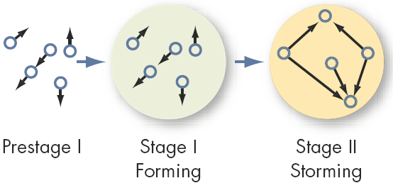
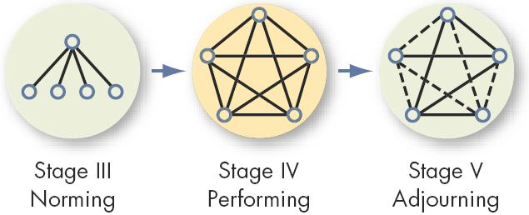
Team Building Activities Tools & Techniques
THE FIVE STAGE TEAM DEVELOPMENT MODEL

Slide 82
Ground Rules Tools & Techniques
Clear expectations regarding acceptable behavior by project team members.
Early commitment to clear guidelines decreases misunderstandings and increases productivity.
Discussing ground rules in areas such as;
Code of conduct
Communication
Working Together
Meeting Etiquette
Shared Responsibility

Slide 83
Establishing Ground Rules Tools & Techniques
Establishing operational ground rules for how the team will work together.
Consists of not only organizational and procedural issues but also how the team will interact with each other.

Slide 84
Colocation Tools & Techniques
Placing many or all of the most active project team members in the same physical location to enhance their ability to perform as a team
Temporary
Permanent
War Room
While Colocation is considered as a good strategy, the use of virtual teams can bring benefits such as proximity of team members to suppliers, customers, or other key stakeholders.

Slide 85
Recognition & Rewards Tools & Techniques
The original plans concerning ways in which to reward people are developed during the ‘Plan Human Resource Management Process’.
Pertinent Aspects
Satisfaction of need which is valued by that individual.
Take care of Cultural Differences.
Tangible & Intangible Rewards.
Team Recognition throughout the Life Cycle
Function of Project Performance Appraisals.

Slide 86
Managing Project Reward System Tools & Techniques
Recognizing individual members regardless of their accomplishments can distract from team unity.
Group Rewards
  Who gets what reward?
  How to make the reward have lasting significance?
  How to recognize individual performance?
    Letters of commendation
    Public recognition for outstanding work
    Desirable job assignments
    Increased personal flexibility

Slide 87
Personnel Assessment Tools Tools & Techniques
These tools give the Project Manager and the project team insight into areas of strength and weakness.
These tools help project managers assess the team preferences, aspirations, how they process and organize information, how they tend to make decisions, and how they prefer to interact with people.
Attitudinal Surveys
Specific Assessments
Structured Interviews
Ability Tests
Focus Groups

Slide 88
Who Performs the Appraisal?
Immediate Supervisor
Higher Management
Self-Appraisals
Peers (Co-Workers)
Evaluation Teams
Customers
“360° Appraisals”

Slide 89
APPRAISAL TYPES
Management by Objectives. MBO evaluates how well an employee has accomplished objectives determined to be critical in job performance. This method aligns objectives with quantitative measures such as sales, profits, zero-defect , units produced.
360 Degree Performance Multi-source Feedback which involves evaluation by all the members of the organization that are in connection with the person in question including himself, his peers, sub-ordinates, supervisors and even the external customers. It usually starts off with self-evaluation but afterwards all relevant supervisors, peers and sub-ordinates evaluate the person in question. This is a modern tool in performance evaluation.
Peer Appraisal Performance appraisal done by one’s fellow employees
Team Performance Appraisal based on TQM concepts, that recognizes team accomplishment rather than individual performance

Slide 90
    WCF
Start your project with clear direction and strong support from your sponsor. Make sure you obtain a charter from the sponsor before you begin project planning. The charter should outline the expectations, limits and priorities for the project. If your sponsor doesn't write the charter, write it with the sponsor or write it yourself and then review it in depth with her. Make sure she signs off on it when you're done. Also, review the charter with each resource manager before you ask him for the resources (people and/or money) you need for the project.
Obtain team member commitment to the project by involving them in project planning. Use a project management method that encourages team participation. Participation builds understanding, commitment and accountability to the project.
Make sure key resource areas have representation on the team. For key stakeholders that do not have representation, assign a team member liaison to communicate with that stakeholder. Also, create a communications plan for regular communications with all stakeholders. Copy resource managers on all status reports and have team member representatives review project status with their resource managers.
When the project plan is complete, review it with each resource manager and have him sign off on it. Approval of the plan signals his commitment to providing the resources as prescribed in the plan. If he refuses to sign, ask him what changes would be required to the plan in order to gain his commitment and approval. Don't begin execution without commitment from the resource managers.
Keep project ownership on the shoulders of the project team during execution. This is done by maintaining team participation during status reviews, when identifying and analyzing problems and creating action plans, and when evaluating change requests. When a problem arises lead the team through a process of deciding on the best course of action. By letting them own the problem and develop a solution, they remain committed to seeing the project through to a successful conclusion.
Solicit help from your sponsor when you can't resolve problems on your own. She should be in a better position to lobby resource managers to provide support than you are. She can also escalate issues for you. Ensure sponsor involvement in the project by working with her to create the charter, inviting her to the kick-off meeting to review the charter with the team, reviewing the project plan with her and having her sign off on it, issuing regular project status reports during execution, holding regular project review meetings with her and soliciting her feedback on the performance of the project and on your own performance throughout the project process.
Solicit feedback from resource managers throughout the project. Feedback can be obtained through face-to-face meetings and/or through simple survey feedback forms. When using a survey form, make sure you close the loop by reporting back to the resource managers on the results of the survey and on your action plan for dealing with the issues raised.

Slide 91
WMPHAW?
Flexible work schedules. The workers had the ability to provide “selfcare” by having the flexibility to manage their personal lives. A flexible schedule helped them to achieve a healthy work-life balance.
A strong sense of engagement in their work. The researcher found that was because of behind-the-scenes support the employees received from their bosses and employers. This support included flex schedules as well as the availability of superiors to consult with and bounce issues off of.
A feeling of being appreciated and valued, which often stemmed from their being included in organizational decision-making.
Having a high degree of freedom built into their jobs, meaning that they wanted the ability to try new things and expand out of their immediate area.
A pleasant physical workspace and good relationships with clients and colleagues.
Having a diversity of responsibilities, which might include training or teaching others, research, and policy development work.
Having a mentor to talk about their life, career decisions and their day-to-day job.

